Slide 1
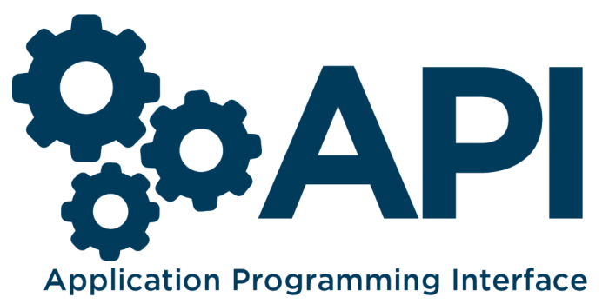


Slide 2
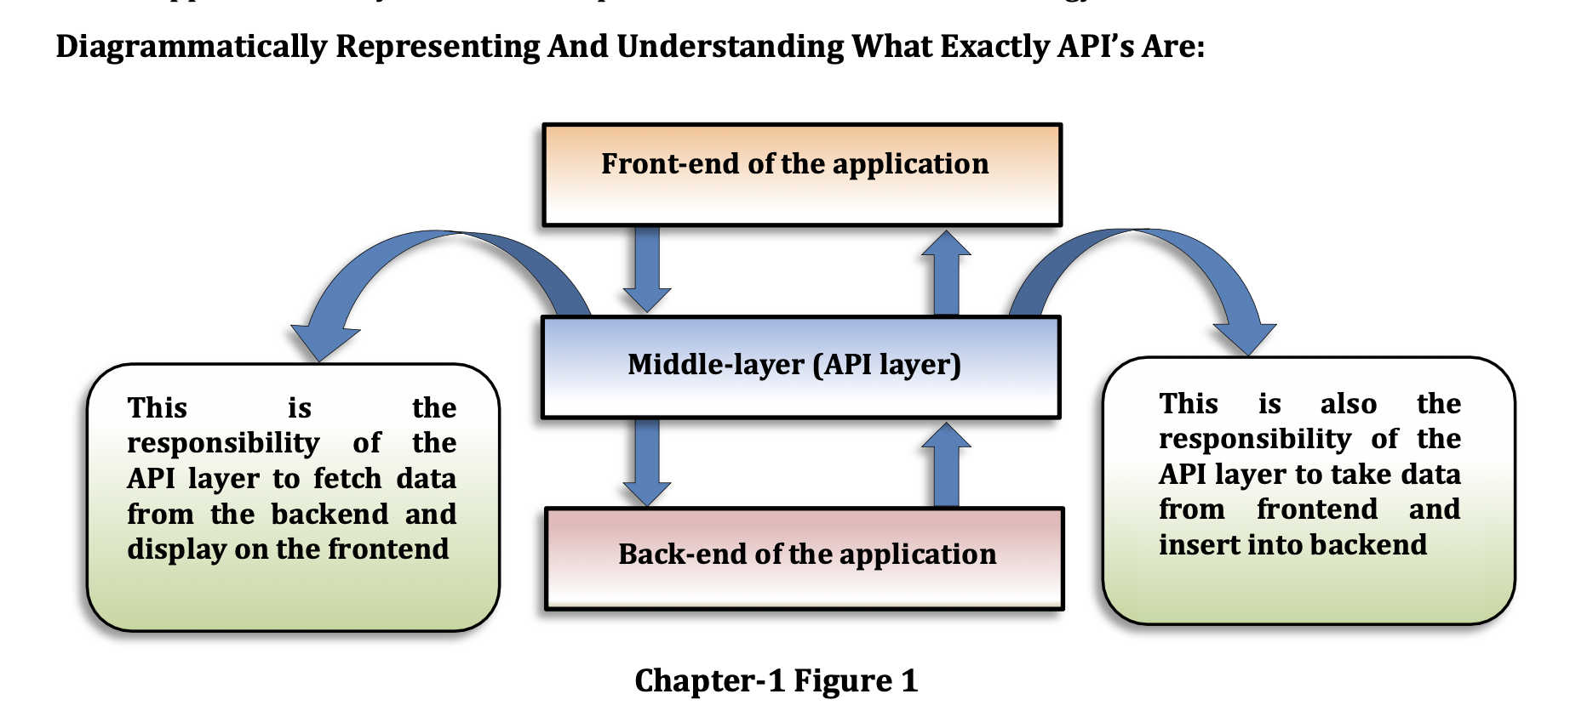
What is the API?
An API takes your requests from the device and fetch the response from the server.
Application Programming Interface (API): Is the way of communication between two applications where applications may differ in their platforms or in terms of technology also.
2

Slide 3
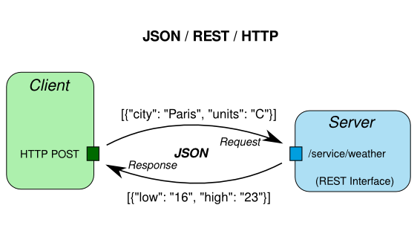

Slide 4
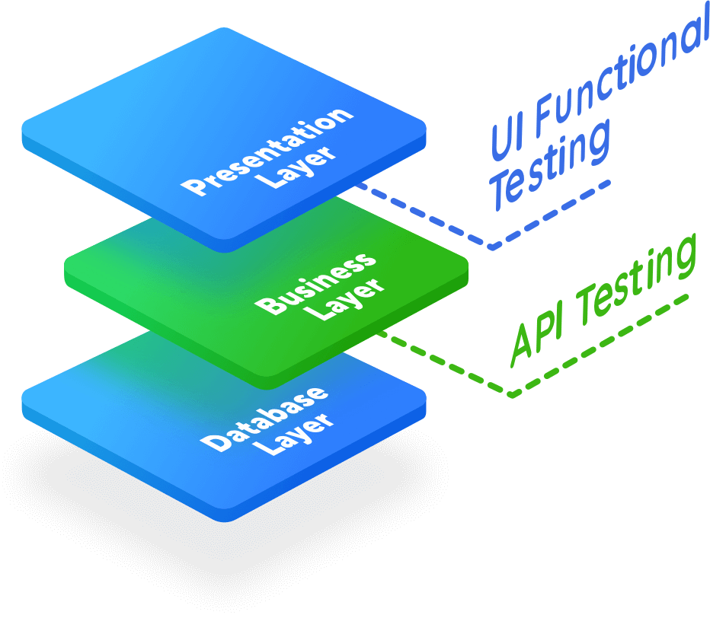
Application Tiers – 3 Layers

Slide 5
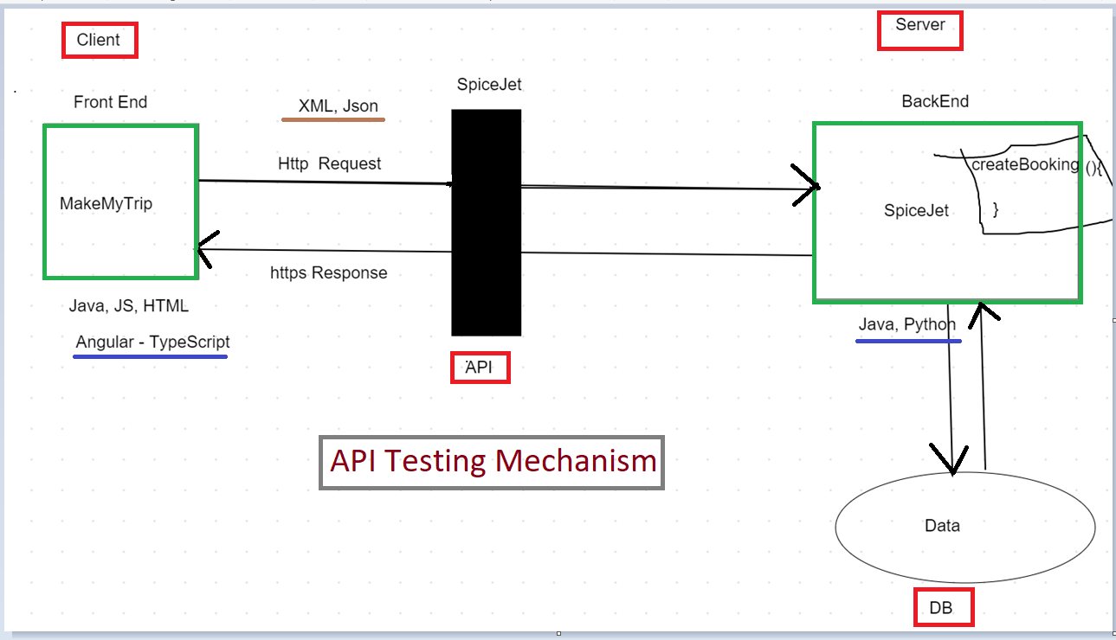
Diagram

Slide 6
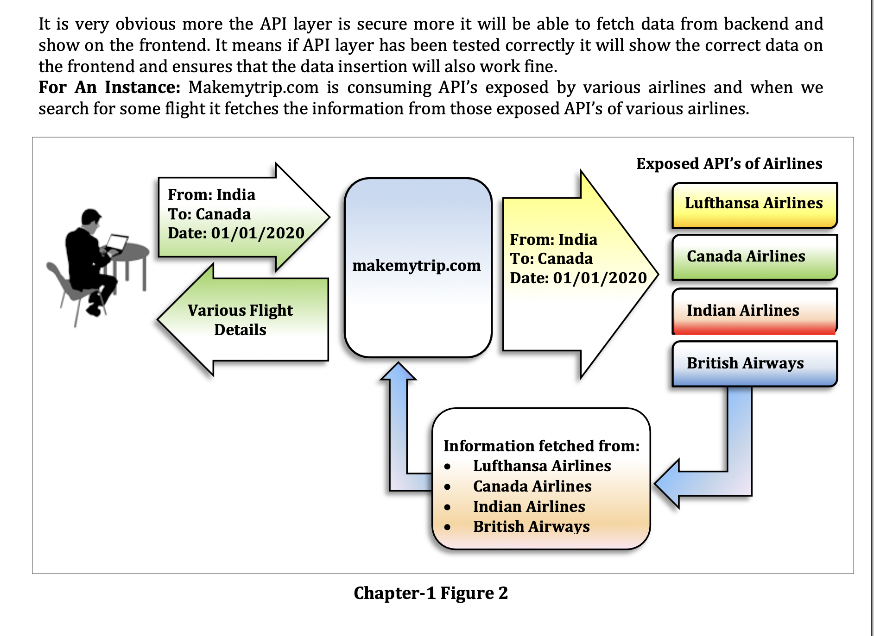
Real-Time Example of API?
6

Slide 7
What is API Testing?
API testing is a process used to assess the performance, security, and usability of APIs.
It aids in finding bugs, problems, and security weaknesses and makes sure the API generates the desired results.
Testing an API's functionality and if it meets stakeholder expectations are the two main goals of this process.
The test needs to cover a wide range of topics, including input validation, managing errors, security, performance, and reliability.

Slide 8
Benefits of API Testing
^{Earlier Testing -}
With API testing, once the logic is designed, tests can be built to validate the correctness in responses and data. We don't have to wait for various teams to finish their work or for full applications to be built - test cases are isolated and ready to built immediately.
Speed and (Coverage) of Testing -
300 UI tests may take 30 hours to run. 300 API tests could be run in 3 minutes. That means you’ll find more bugs in less time, while also being about to fix them immediately.
^{Faster Time To Resolution -}
When API tests fail, we know exactly where our system broke and where the defect can be found.

Slide 9
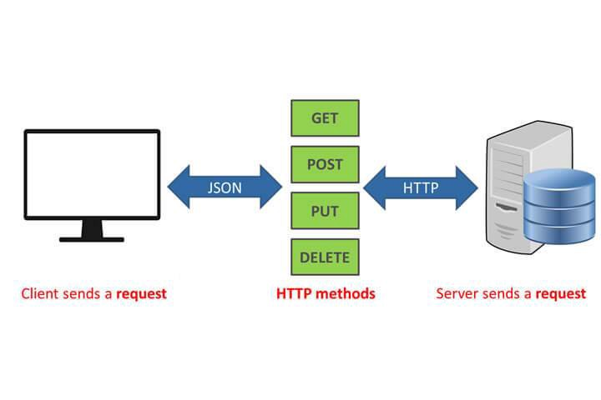


Slide 10
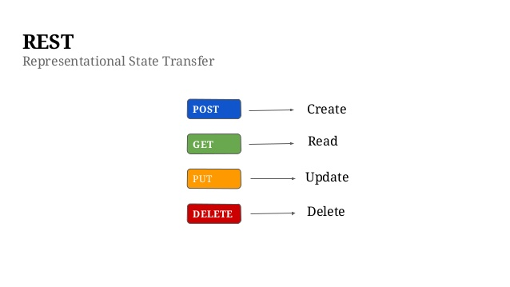


Slide 11
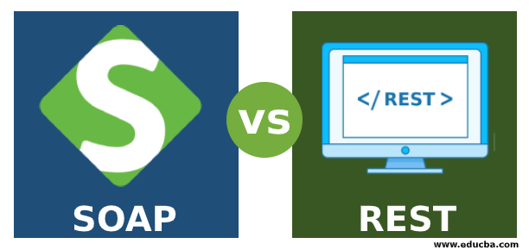

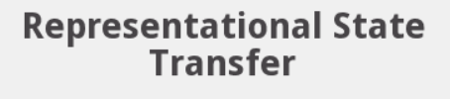
API Types

Slide 12
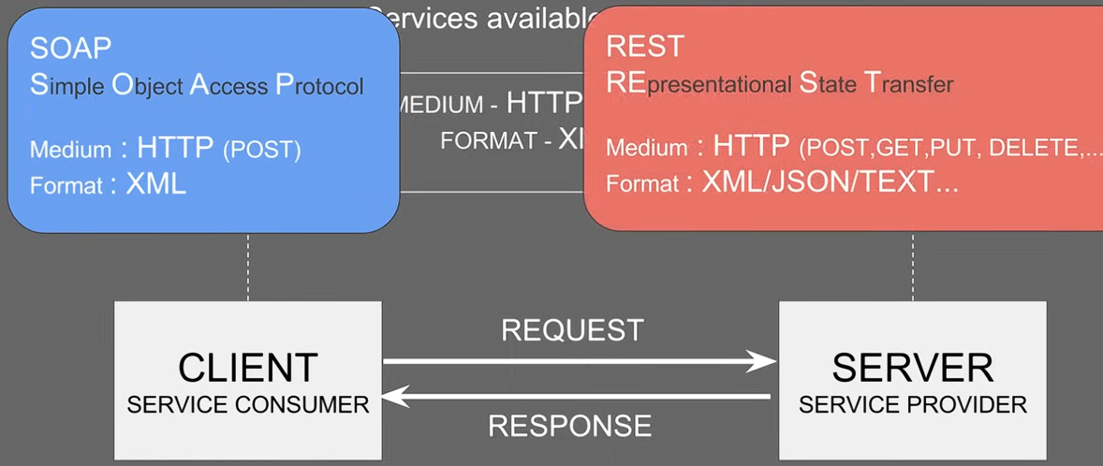

Slide 13
SOAP vs REST
SOAP | REST
SOAP is a protocol through which two computer communicates by sharing XML SOAP permits only XML SOAP based reads cannot be cached SOAP is like custom desktop application, closely connected to the server SOAP is slower than REST It runs on HTTP but envelopes the message | Rest is a service architecture and design for network-based software architectures REST supports many different data formats REST reads can be cached A REST client is more like a browser; it knows how to standardized methods and an application has to fit. REST is faster than SOAP It uses the HTTP headers to hold meta information

Slide 14
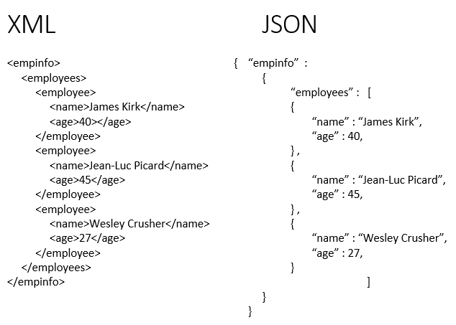
JSON → JavaScript Object Notation
XML → eXtensible Markup Language
JSON → Lightweight, easy to read, used mostly in modern APIs
XML → Older, more structured, used in protocols like SOAP

Slide 15
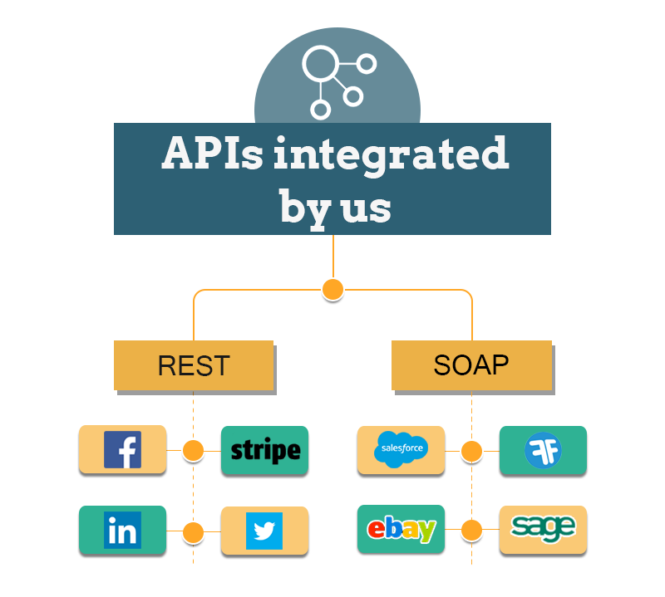

Slide 16
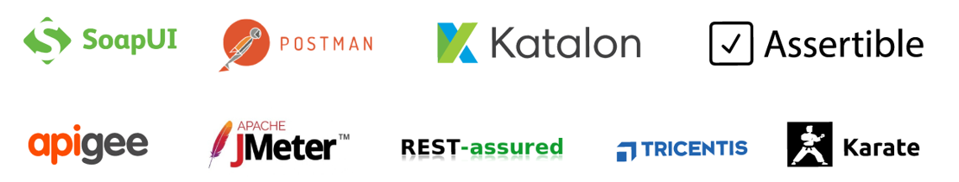
API Testing Tools

Slide 17
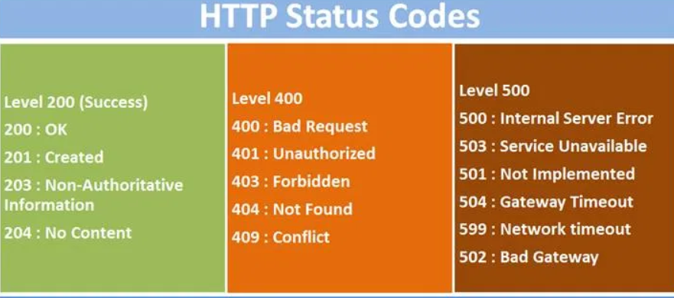

Slide 18
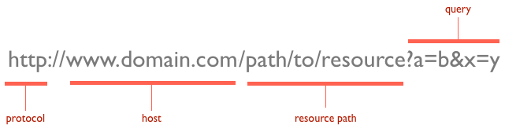
URL Structure

Slide 19
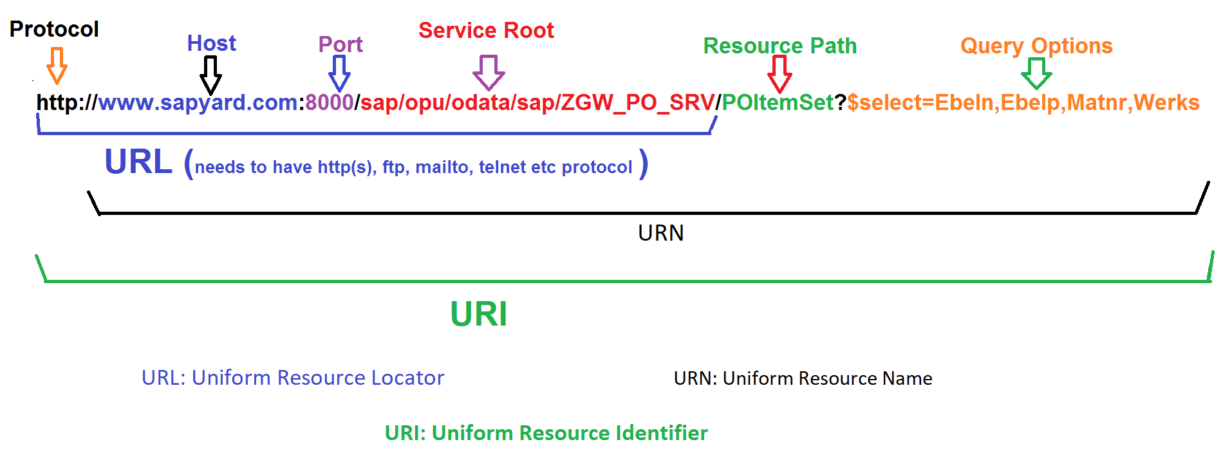
URL, URN, URI

Slide 20
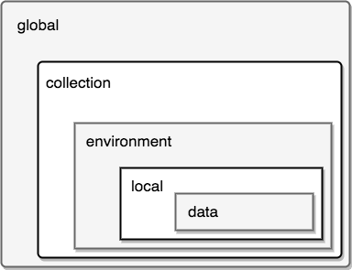
Variables

Slide 21
REST API
Application Programming Interface
It allows software applications to communicate with each other via API Calls
REST – Representational State Transfer
Ex: Google search, Weather Report.
4 Methods
GET – Extract data
POST – Create new
PUT - Update existing one
DELETE – Removes all current representations

Slide 22
Interview Questions
Postman
Part-1
1. API Documentation - SwaggerUI
2. How to integrate excel with rest assured
3. What is the protocal used in your api testing?
4. What are the protocal methods?
5. How will you do the data validation?
6. Diff JSON Object and JSON Array
7. What is JsonPath? its uses.
8. How will you pass the request?
Ans:- PayLoad (JSON File)
- Can create using POJO class

Slide 23
Interview Questions
Part-2
9. What is Serialization?
Ans: Java Object --> JSON OBject
i.e: Creating PayLoad
10. What is De-Serialization?
Ans: JSON Object --> JSON Object
Data validation
11. How will you acheive that?
- Using POJO Class
12. Status code?
13. diff Put & Patch
14. What is the framework?
- Cucumber-BDD

Slide 24
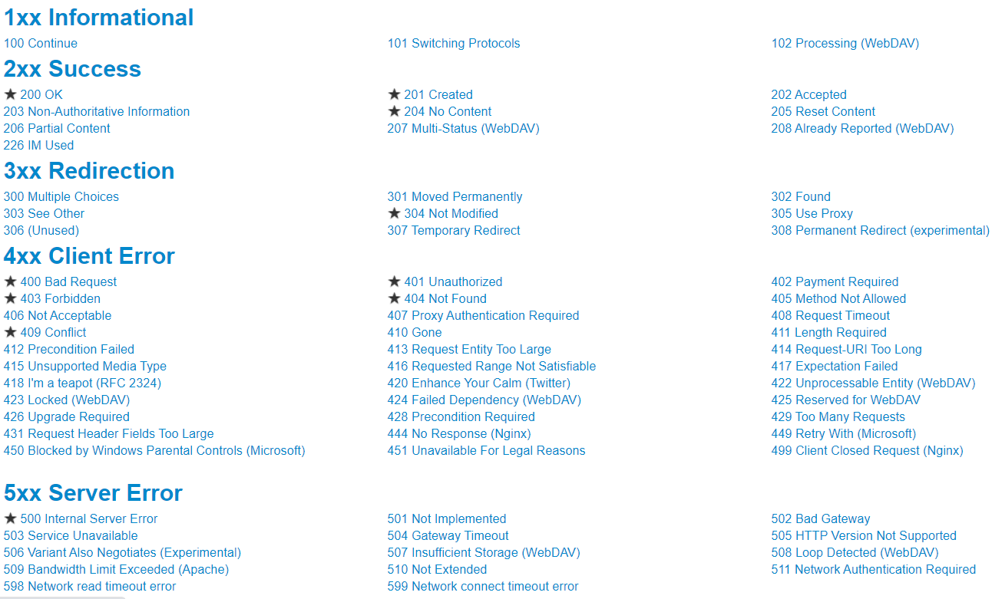

Slide 25
Swagger
Swagger is a framework for describing your API by using a common language that is easy read and understand by developers and testers. Its like blueprint for a house.
Swagger UI, a part of Swagger, is an open source tool that generates a web page that documents the APIs generated by the Swagger specification.
This UI presentation of the APIs is user friendly and easy to understand, with all logic complexity kept behind the screen.
This enables developers to execute and monitor the API requests they sent and the results they received, making it a great tool for developers, testers and end consumers to understand the end points they are testing.
Swagger UI represents apis within browser so brings more intuitively than other tools such as: Postman, SoapUI, and others.
SwaggerUI

Slide 26
REST API Authentication Methods
No auth
API key
Bearer token
Basic auth
OAuth

Slide 27
Multi Factor Authentication
How to choose a automation Framework

Slide 28
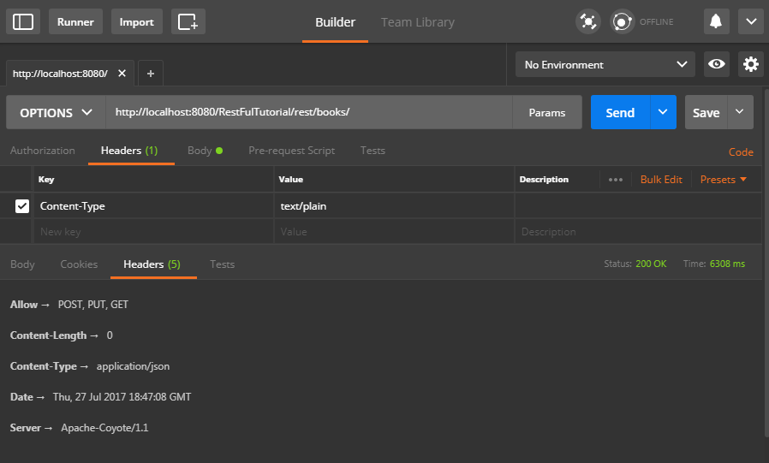
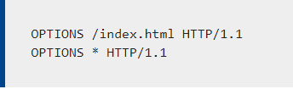
Options in API
The HTTP OPTIONS method requests permitted communication options for a given URL or server.
A client can specify a URL with this method, or an asterisk (*) to refer to the entire server.
Syntax:

Slide 29
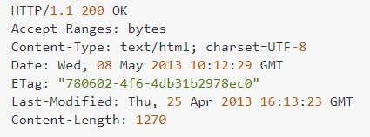
Head in API
The HEAD method is similar to the GET method except the message body is not returned in response.
The response only includes meta-information, such as a response code or corresponding headers.
Checking whether a resource has changed. This is useful when maintaining a cached version of a resource
Retrieving metadata about the resource,
Eg. its media type or its size, before making a possibly costly retrieval

Slide 30
Header
HTTP headers let the client and the server pass additional information with an HTTP request or response
Example:
Accept-* headers indicate the allowed and preferred formats of the response

Slide 31
All Headers
The JSON API uses the following standard HTTP headers:
Authorization Content-ID Content-Length Content-Range | Content-Type Date Host Range

Slide 32
Request Header
A client sends request header fields to provide more information about the request context, make the request conditional based on
the target resource state,
suggest preferred formats for the response,
supply authentication credentials, or
modify the expected request processing.
These fields act as request modifiers, similar to the parameters on a programming language method invocation.

Slide 33
Response Header
The response header fields allow the server to pass additional information about the response beyond what is placed in the status- line.
These header fields give information about the server, about further access to the target resource, or about related resources.
Although each response header field has a defined meaning, in general, the precise semantics might be further refined by the semantics of the request method and/or response status code.

Slide 34
Accept & Content-Type
Accept
The "Accept" header field can be used by user agents to specify response media types that are acceptable.
Content-Type
The "Content-Type" header field indicates the media type of the associated representation

Slide 35
Payload
The Payload of an API Module is the body of your request and response message. It contains the data that you send to the server when you make an API request.
You can send and receive Payload in different formats, Ex., JSON.

Slide 36
Cache vs Cookies
Cache
It is used to store online page resources during a browser for the long run purpose or to decrease the loading time.
It consumes large space in terms of capacity.
Cookies
are employed to store user choices such as browsing session to trace the user preferences.
While it consumes less space in terms of capacity.

Slide 37
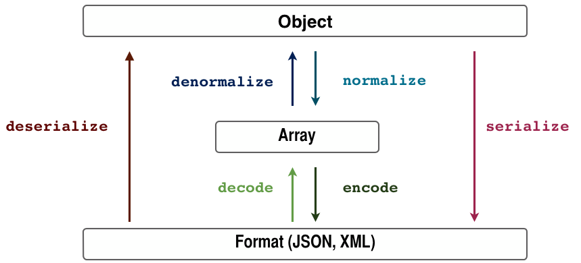
Serialization vs Deserialization

Slide 38
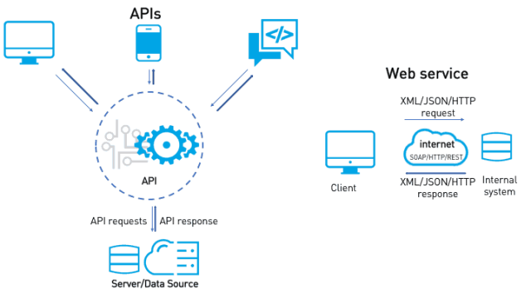
API Vs Web Services

Slide 39
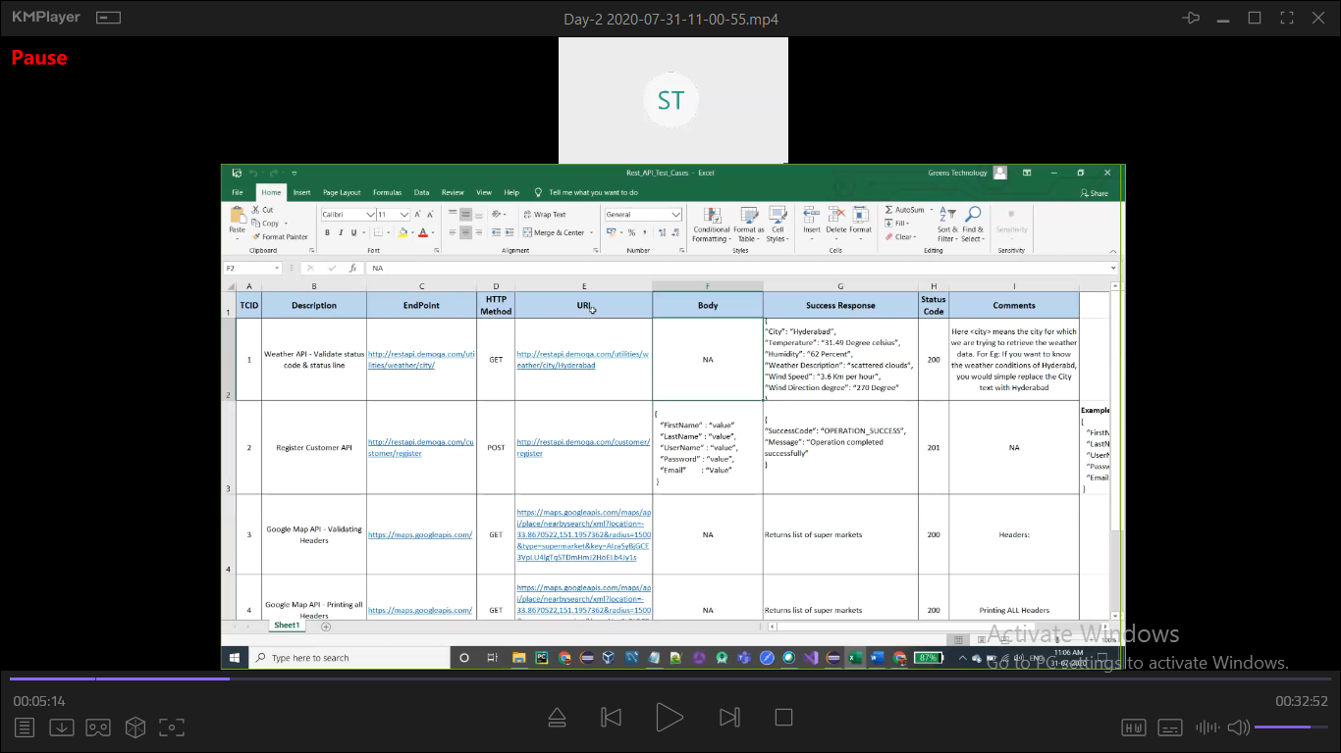
Testcase

Slide 40
API Testing Challenges
1. Initial Setup of API Testing
2. Updating the Schema of API Testing
3. Testing Parameter Combinations
4. Sequencing the API Calls
5. Validating Parameters

Slide 41
Questions
Can we use GET request instead of PUT to create a resource?
Idempotent

